Slide 1
Medicaid

Slide 2
Traditional Medicaid Plan
Members eligible for Traditional Medicaid include:
Children
Pregnant Women
Aged, Blind or Disabled Adults
Women eligible under the Cancer Program
Some services are available only to children and to pregnant women under Traditional Medicaid
If a parent is a minor child and is the head-of-household on Family Medicaid, the minor parent will be covered by Traditional Medicaid

Slide 3
Non-Traditional Medicaid Plan
Members eligible for Non-Traditional Medicaid include:
Adults on Family Medicaid programs (adults with dependent children)
Adult care-taker relatives on Family Medicaid
Services are based on the program type a person is eligible to receive

Slide 4
Targeted Adult Medicaid (TAM) Program
On November 1, 2017, CMS approved the program to provide Medicaid coverage for adults without dependent children earning up to 5% of the federal poverty level (FPL) who are:
Chronically homeless
Involved in the justice system through probation, parole, or court ordered treatment needing substance abuse or mental health treatment
Needing substance abuse treatment or mental health treatment

Slide 5
Billing a Managed Care Entity
Medicaid contracts with Managed Care Entities (MCE) to deliver medical, dental, mental health, and substance use disorder (SUD) services to Medicaid member
Medicaid members may have Fee for Service Medicaid, or an MCE depending on where they reside
Providers are responsible for verifying Medicaid eligibility and determining if a member is enrolled with an MCE before rendering services
Providers can verify a member’s Medicaid eligibility by using the Eligibility Lookup Tool (ELT) located at: https://Medicaid.Utah.gov/eligibility
A provider who accepts Medicaid agrees to accept the MCE payment as payment in full; this includes any deductible, co-insurance, or co-payment owed by the Medicaid member

Slide 6
Billing an Accountable Care Organization
If a Medicaid member received a physical health service, send the claim to the Accountable Care Organization (ACO). An ACO contracts with Medicaid to pay for physical health services provided to Medicaid members enrolled with the ACO.
Currently over 80% of Medicaid members receive their physical health benefit from an ACO
In order to provide services to members enrolled in an ACO, providers must contract directly with each ACO plan
When required, providers must obtain prior authorization directly from the ACO plan
Utah Medicaid’s ACOs include: Health Choice, Healthy U, Molina, and Select Health
Enrollment in an ACO is mandatory in Box Elder, Cache, Davis, Iron, Morgan, Rich, Salt Lake, Summit, Tooele, Utah, Wasatch, Washington, and Weber counties
Enrollment in an ACO for Medicaid members in other counties is voluntary
ACOs are required to cover the same services that the Medicaid Fee for Service Network covers

Slide 7
Billing a Dental Plan
Utah Medicaid contracts with dental managed care plans to pay for dental services provided to Medicaid members. If a Medicaid member received a dental service, send the claim to the dental plan.
Utah Medicaid’s dental plans are: MCNA and Premier Access
In order to provide services to members enrolled in a dental plan, providers must contract directly with each plan
When required, providers must obtain prior authorization directly from the dental plan
Pregnant women, Medicaid members eligible for Early and Periodic Screening, and Diagnostic, and Treatment (EPSDT) benefits, and members who are eligible due to being visually impaired or having a disability will be enrolled with a dental plan
The dental plans must cover the same services that the Medicaid Fee for Service Network covers

Slide 8
Billing a Dental Plan
Adults who are eligible for Medicaid due to a disability or visual impairment and who want to receive services through the University of Utah School of Dentistry may do so, regardless of the dental plan they are enrolled in. The University of Utah will bill the state directly for these services.
For more information regarding U of U School of Dentistry services and locations call (801) 587-6453
Dental services received from an Indian Health care provider will continue to be billed directly to Medicaid regardless of the member’s dental plan.

Slide 9
Targeted Adult Medicaid (TAM)Dental Benefits
Dental services are available to eligible Targeted Adult Medicaid (TAM) members who are actively receiving treatment in a substance abuse treatment program as defined in Utah State Code Section 62A-2-101, licensed under Title 62A, Chapter 2, Licensure of Programs and Facilities
Dental services for this population shall be provided through the University of Utah School of Dentistry and their statewide network of contracted dentists
Program coverage and limitations will be updated and available in Utah Administrative Rule R414-49, Utah Medicaid Provider Manual: Dental, Oral Maxillofacial, and Orthodontia Services, and the Utah Medicaid Coverage and Reimbursement Code Lookup

Slide 10
Billing a Prepaid Mental Health Plan
Under the Prepaid Mental Health Plan (PMHP), Medicaid contracts with local county mental health and substance abuse authorities to provide mental health and SUD services to Medicaid members.
Prior to delivering services, providers must verify the member’s PMHP through the Medicaid Eligibility Lookup Tool (https://Medicaid.Utah.gov/eligibility)
If a Medicaid member is enrolled in the PMHP, the provider must either refer the member to his or her PMHP for services, or ask the PMHP for authorization before providing services
Otherwise, the PMHP might not pay the provider
All Medicaid members enrolled in the PMHP may also get their services directly from a federally qualified health center (FQHC)
PMHP authorization is not required
American Indian and Alaska Native Medicaid members may get their services directly from Indian Health Services (IHS), or a tribal or Urban Indian Organization (UIO) facility
PMHP authorization is not required
Medicaid members with Subsidy Adoption Medicaid may be disenrolled from their PMHP on a case-by-case basis for outpatient mental health and outpatient SUD services
They remain enrolled in the PMHP for inpatient psychiatric hospital care

Slide 11
Grievances, Appeals and Hearings
MCEs are required by federal regulations to have a Grievance and Appeals System.
Appeals of Adverse Benefit Determinations: An appeal is a review by an MCE of an adverse benefit determination (ABD). ABDs include, but are not limited to MCE’s denying payment in whole or part, denying or limiting authorization of a requested service, etc.
If an MCE makes an ABD, the MCE must send notice of the ADB explaining how to request an appeal of the ABD. An appeal request must be filed with the MCE within 60 calendar days from the date on the notice of the ABD.
If the MCE’s appeal decision is adverse, a State fair hearing with the Medicaid Agency may be requested. A hearing must be requested within 120 calendar days from the date of the MCE’s notice of ABD resolution.
Grievances: A grievance is an expression of dissatisfaction about any matter other than an ABD. Grievances may include, but are not limited to the quality of care or services provided by the MCE, rudeness of MCE providers or employees, failure to respect Medicaid member’s rights, etc.
Grievances may be filed with the MCE at any time. MCEs must address the grievance within 90 calendar days from the date the MCE receives the grievance.

Slide 12
Patient Eligibility Lookup Tool
https://medicaid.utah.gov
Need Utah ID to access the tool
Notes:
Prior Authorization is located under Health Care Providers
Section Contains Everything you need in order to complete and submit a prior authorization

Slide 13
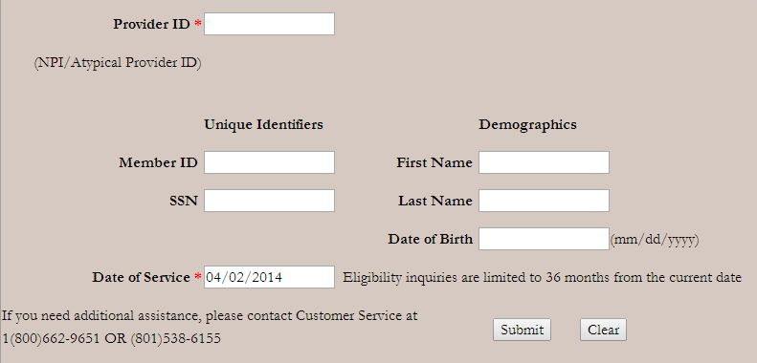
Eligibility Lookup Tool
https://medicaid.utah.gov/eligibility-lookup-tool
To submit an eligibility inquiry on a specific member, enter your Provider ID, date of service and a combination of the following search criteria:
One value from the ‘Unique Identifiers’ column, and two values from the ‘Demographics’ column
OR
All three values from the ‘Demographics’ column
Only exact matches will return results

Slide 14
Fee For Service Network
Providers should note that the Eligibility Lookup Tool currently displays “Fee For Service Network” when a member is not enrolled in a managed care plan
Fee For Service claims should be billed to state Medicaid
Notes:
The red arrow indicates which health plan the member is enrolled with.

Slide 15
Medicaid Member
A Medicaid member is required to present the Medicaid Member Card before each service
Provider’s must verify each member’s eligibility every visit before rendering services
Presentation of the Medicaid Member Card does not guarantee a member is eligible for Medicaid
Verify the member’s eligibility; determine whether the member is enrolled in a Managed Care Organization (MCO), Emergency Only Program, or the Restriction Program; assigned to a Primary Care Provider; covered by a third party; or responsible for a co-payment or co-insurance
Eligibility and health plan enrollment may change from month to month
Retain documentation of the verified eligibility for billing purposes
Verify member eligibility using Access Now, Eligibility Lookup Tool, or ANSI 270/271

Slide 16
Member Cost Sharing
Cost sharing in the Medicaid program can include co-insurance, co-payment, deductibles, and premiums.
Some Medicaid members share the cost for certain services including:
prescription drugs
inpatient hospital services
non-emergent use of emergency department services

Slide 17
Member Cost Sharing
The Utah Medicaid State Plan change updated cost sharing amounts to align with requirements in 42 CFR §447.50, Sections 1902(a)(14), 1916, and 1916A of the Act.
The cost sharing amounts are as follows:
$8 for each non-emergency use of the emergency department
$75 for each inpatient hospital stay (episode of care)
$4 for each outpatient services visit (physician visit, podiatry visit, physical therapy, etc.)
$4 for each outpatient hospital service visit (maximum of one per person, per hospital, per date of service)
$4 for each prescription
$1 for each chiropractic visit (maximum of one per date of service)
$3 for each pair of eyeglasses

Slide 18
Services Exempt from Co-payment
Some services are exempt from co-payment
Even if a member ordinarily has a co-payment, do not collect a co- payment for the following services:
Family planning
Preventive services, including vaccinations and health education
Pregnancy-related (including tobacco cessation)
Emergency services
Provider-preventable condition (PPC) services
Note: Non-emergent use of an emergency room requires a co-pay

Slide 19
Members Exempt from Co-payment
Federal regulations exclude certain services from cost sharing, including:
Individuals through the age 18 years of age
Any individual whose medical assistance for services are furnished in an institution
American Indian and Alaska Native (AI/AN) individuals
Individuals whose total gross income, before exclusions and deductions, is below the temporary assistance to needy families (TANF) standard payment allowance
These individuals must indicate their income status to their eligibility caseworker on a monthly basis to maintain their exemption from the co-payment requirements
Qualified Medicare Beneficiaries (QMB)
Individuals who are receiving Medicaid due to having breast or cervical cancer

Slide 20
Member Responsibilities
A Medicaid member is responsible for certain costs, including:
Charges incurred during a time of ineligibility
Charges for non-covered services, including services received in excess of Medicaid benefit limitations
Charges for services which the member has chosen to receive and agreed in writing to pay as a private-pay member
Spend down liability
Cost sharing amounts such as premiums, deductibles, co-insurance, or co-payments imposed by the Medicaid program

Slide 21
Billing Medicaid Members
Payment made by Medicaid for a service is considered payment in full
Once the payment is made to the provider for covered services, no additional reimbursement can be requested from the member
Medicaid members may be billed for co-payments and co-insurance
Medicaid members may only be billed for broken appointments if the provider has a policy in place to bill for broken appointments that applies to all patients (not just Medicaid members) and the member has signed an agreement to pay for broken appointments

Slide 22
Billing Medicaid Members
A Traditional and Non Traditional Medicaid member may be billed for non-covered services when all four of the conditions below are met:
The provider has an established policy for billing all patients for services not covered by a third party
The member is advised prior to receiving a non-covered service
The member agrees to be personally responsible for the payment
That agreement is in writing between the provider and the member which details the service and the amount to be paid by the member
For complete information regarding billing Medicaid members see Utah Medicaid provider manual
Section 1, Chapter 7

Slide 23
Billing Medicaid Members
Sample of financial agreement form is available on the website
https://medicaid.utah.gov/utah-medicaid-forms

Slide 24
Billing for Emergency Services Provided to a Non-Citizen
Because the Emergency Medicaid program for non-citizens has a very restricted scope of services, it does not have some of the same restrictions on billing the member, as is the case in other Medicaid covered services
If a provider does not receive payment from Medicaid because the provider failed to follow procedure to get a service covered, the provider is prohibited from pursuing payment from the member
However if payment is not made because the service was not an emergency or the service is not covered under the program, then the member can be billed for those services
If a service is a covered service and meets the Medicaid definition of “emergency” Medicaid will pay for the service (subject to correct coding)
However, if a non-citizen eligible for emergency services only presents at the ER with symptoms that do not appear to be emergent in nature, the provider would be prudent to inform the member prior to the service that the service might not be covered by Medicaid
In that case the member will be financially responsible for paying the bill

Slide 25
Charges That Are Not the Responsibility of the Member
Except for the cost sharing responsibilities discussed previously, members are not responsible for the following charges:
A claim or portion of a claim that is denied for lack of medical necessity (for exceptions refer to Chapter 3, Provider Participation and Requirements, Exceptions to Prohibition on Billing Members)
Charges in excess of Medicaid maximum allowable rate
A claim or portion of a claim denied due to provider error
A service for which the provider did not seek prior authorization or did not follow up on a request for additional documentation
A claim or portion of a claim denied due to changes made in state or federal mandates after services were performed
The difference between the Medicaid cost sharing responsibility, if any, and the Medicare or Medicare Advantage co-payments

Slide 26
Charges That Are Not the Responsibility of the Member
Medicaid pays the difference, if any, between the Medicaid maximum allowable fee and the total of all payments previously received by the provider for the same service by a responsible third party
Members are not responsible for deductibles, co-payments, or co-insurance amounts if such payments when added to the amounts paid by third parties, equal or exceed the Medicaid maximum for that service, even if the Medicaid amount is zero
The member is not responsible for private insurance cost share amounts if the claim is for a Medicaid covered service by a Medicaid enrolled provider who accepted the member as a Medicaid member
Medicaid pays the difference between the amount paid by private insurance and the Medicaid maximum allowed amount
Medicaid will not make any payment if the amount received from the third party insurance is equal to or greater than the Medicaid allowable rate

Slide 27
Coverage and Reimbursement
The Bureau of Coverage and Reimbursement (BCRP) is continuing to make substantial changes to provider manuals it oversees.
BCRP is moving policy from the provider manuals to the appropriate Utah Administrative Rule within R414, Health, Health Care Financing, Coverage and Reimbursement Policy
The changes are detailed in the Utah State Bulletin as they go through the rule-making process
Providers are encouraged to become familiar with Administrative Rule in order to find Medicaid coverage policy for specific services

Slide 28
Coverage and Reimbursement Lookup Tool
Specific coverage for CPT or HCPCS codes is found in the Utah Medicaid Coverage and Reimbursement Code Lookup.
The Coverage and Reimbursement Code Lookup allows providers to search for coverage and reimbursement information by procedure code, date of service, and provider type
Provider manuals and attachments may be found at Utah Medicaid Official Publications.
Providers are encouraged to become familiar with the updated rules and manuals noting changes in the structure, formatting, and content of the manuals

Slide 29
Coverage and Reimbursement Lookup Tool
https://medicaid.utah.gov
Notes:
Prior Authorization is located under Health Care Providers
Section Contains Everything you need in order to complete and submit a prior authorization

Slide 30
Medicaid Manuals
https://medicaid.utah.gov
Notes:
Prior Authorization is located under Health Care Providers
Section Contains Everything you need in order to complete and submit a prior authorization

Slide 31
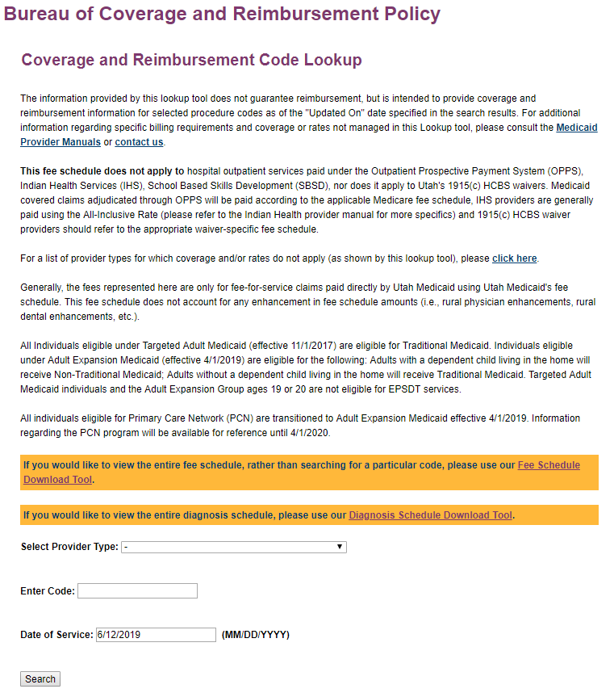
Coverage and Reimbursement Lookup
Select appropriate provider type
Enter 5 character HCPCS/CPT code
Enter date of service (if future, keep current date)
Inquire on retroactive coverage for the previous 2 years
Non-covered services will show up as “not billable by provider type”
Notes:
The Coverage and Reimbursement Code Lookup will provide detailed code specific coverage information.

Slide 32
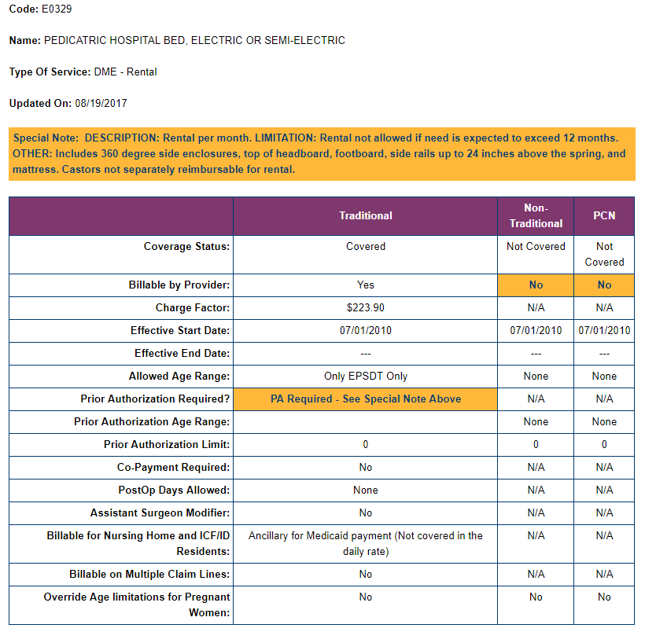
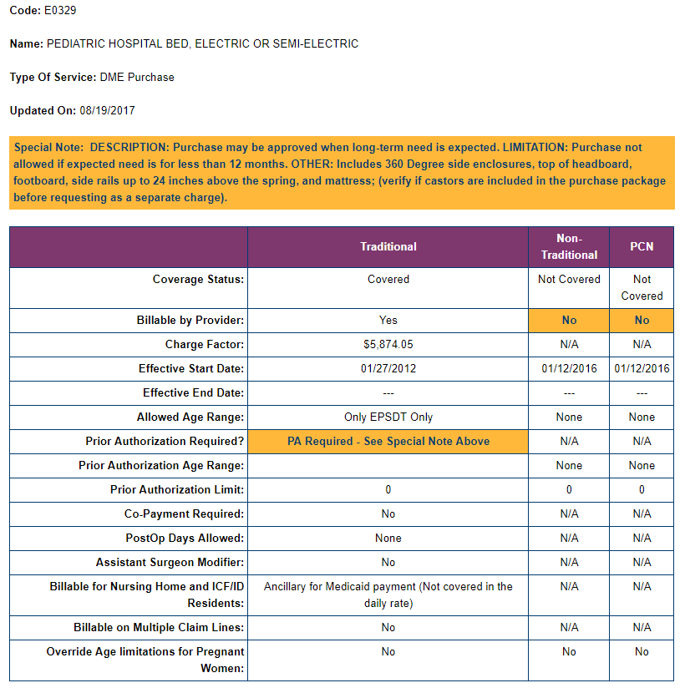
Coverage and Reimbursement Lookup
Notes:
Make sure you are scrolling down when looking up codes. This is an example for a pediatric hospital bed. One table provides information for a rental, and the other for a purchase. Pay attention to the special notes, as the information provided may differ.

Slide 33
Medicaid Manuals
https://medicaid.utah.gov
Notes:
Prior Authorization is located under Health Care Providers
Section Contains Everything you need in order to complete and submit a prior authorization

Slide 34
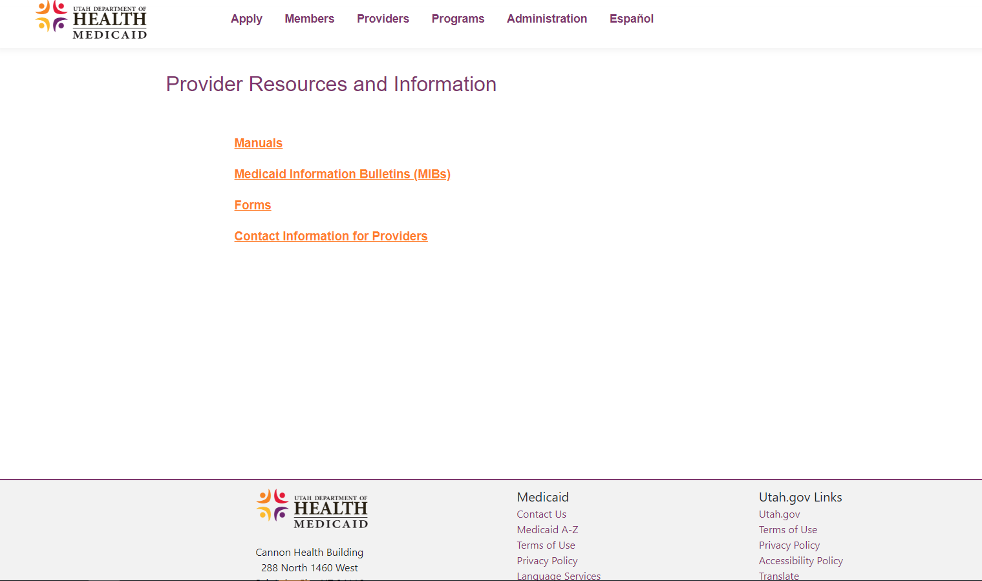
Medicaid Manuals
https://medicaid.utah.gov
Notes:
Prior Authorization is located under Health Care Providers
Section Contains Everything you need in order to complete and submit a prior authorization

Slide 35
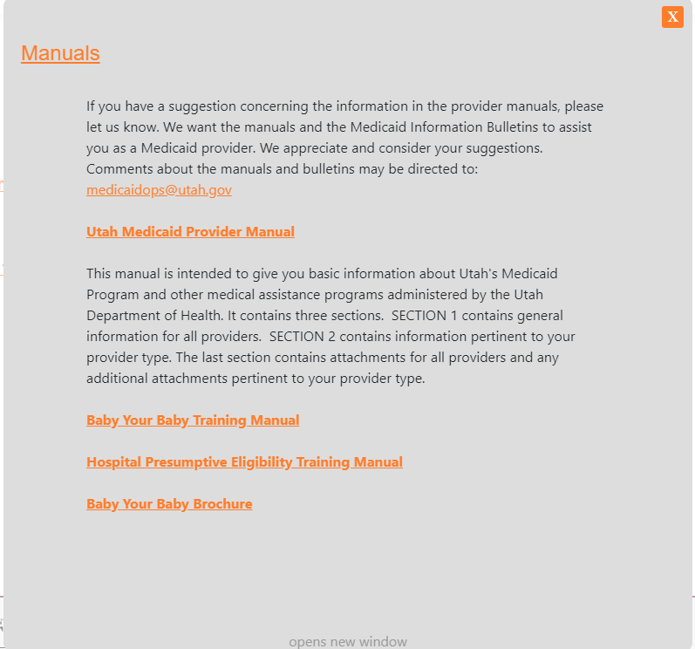
Medicaid Manuals

Slide 36
Medicaid Manuals

Slide 37
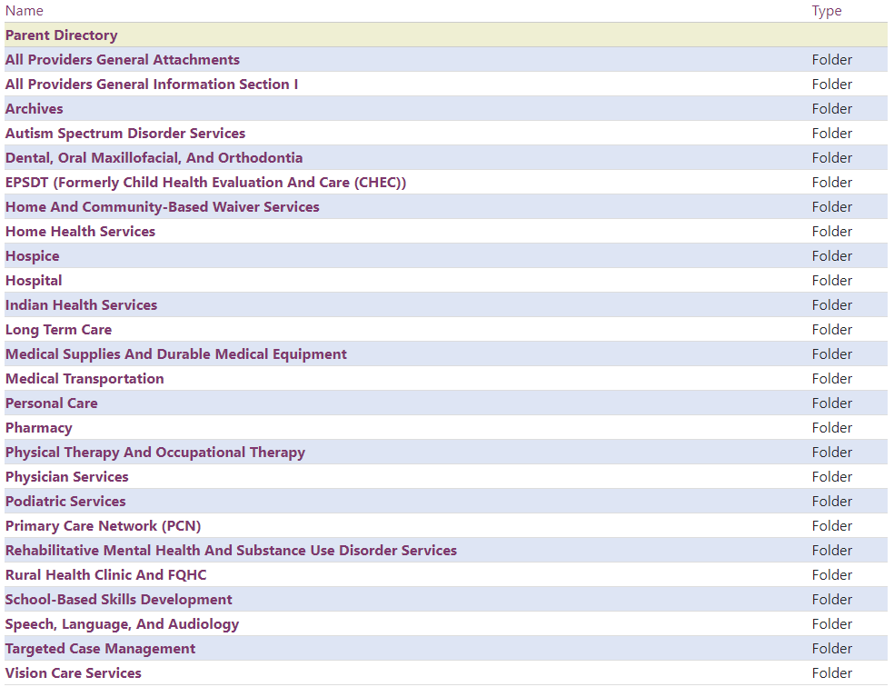
Medicaid Manuals

Slide 38
Medicaid Forms
https://medicaid.utah.gov
Notes:
Prior Authorization is located under Health Care Providers
Section Contains Everything you need in order to complete and submit a prior authorization

Slide 39
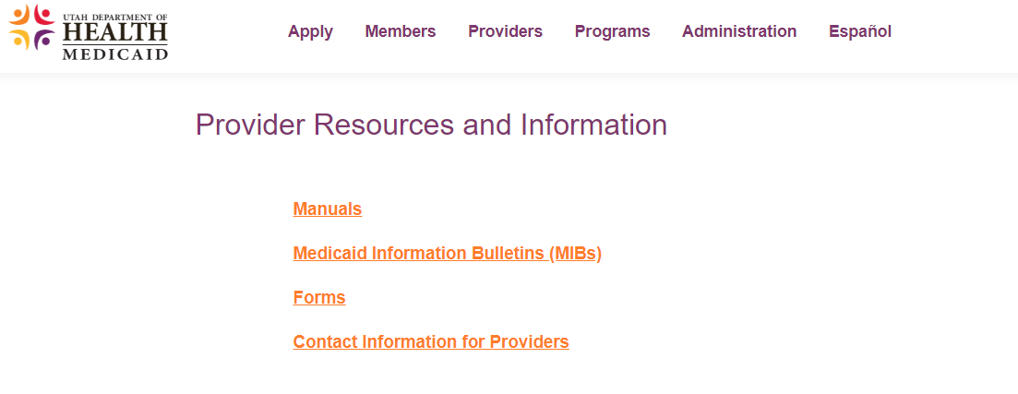
Medicaid Forms
https://medicaid.utah.gov
Notes:
Prior Authorization is located under Health Care Providers
Section Contains Everything you need in order to complete and submit a prior authorization

Slide 40
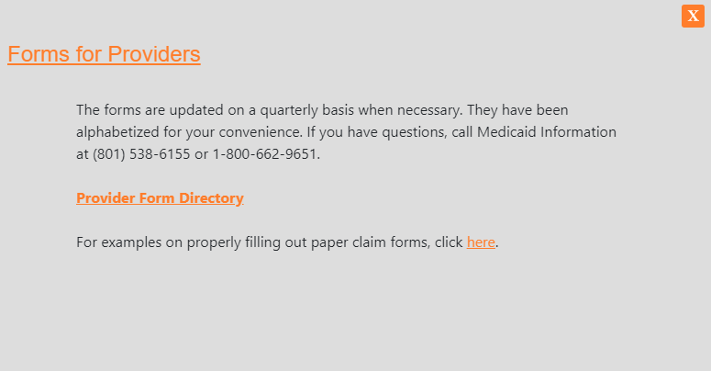
Medicaid Forms
https://medicaid.utah.gov
Notes:
Prior Authorization is located under Health Care Providers
Section Contains Everything you need in order to complete and submit a prior authorization

Slide 41
Medicaid Forms
https://medicaid.utah.gov
Notes:
Prior Authorization is located under Health Care Providers
Section Contains Everything you need in order to complete and submit a prior authorization

Slide 42
Coordination of Benefits
Before submitting a claim to Medicaid, a provider must submit and secure payment from all other liable parties such as Medicare Part A and B
For more information, refer to the Medicaid General Information Section 1, Chapter 11
Claims denied from Medicare as non-covered services should be submitted to Medicaid Fee For Service, not to the crossover mailbox
If the primary payer made line level payments on the claim, please report line level data in addition to the claim level data to Medicaid

Slide 43
Coordination of Benefits
Medicaid is the payer of last resort
Reimbursement for crossover claims or other TPL will be limited to the Medicaid Fee Schedule for all types of service, including FQHC and Indian Health Services
HT000004-001 Medicaid Fee For Service electronic mailbox
HT000004-005 Utah Medicaid Crossovers (NOT when Medicare denies as non-covered) electronic mailbox
Corresponding EOB for Zero Pay from Medicare go to fax (801) 323-1584), not to ORS
Corresponding EOB for Zero Pay for other than Medicare goes to ORS fax (801 536-8513)

Slide 44
Void/Replacement Claims
Providers should submit their own corrections to claims less than 3 years old by submitting either a replacement or void claim
The data elements needed to identify a replacement or void claim are:
Claim Frequency Code (7 For Replacement, 8 For Void)
Electronic: X12 Element 2300 CLM05-3
Paper: UB04 - Form Locator 4, Position
CMS1500 - Box 22 (Code)
Transaction Control Number (TCN) of original claim to be replaced/voided
Electronic: X12 Element 2300 REF02
Paper: UB04 - Form Locator 37 A-C
CMS1500 - Box 22 (Original transaction control number )

Slide 45
Payment Adjustment / Over Payment or Credit Balance
An electronic ‘Payment Adjustment Request Form’ for Fee For Service is available for issues regarding overpayments and credit balance on claims more than 3 years old
If a payment adjustment is required on a claim that is less than 3 years old, a replacement claim must be submitted
The form is located at: https://medicaid.utah.gov/utah-medicaid-forms
The form may be filled out online before printing
One form is required per claim
All required fields must be appropriately filled out or it will be returned to provider

Slide 46
Payment Adjustment Request Form
Checks for Medicaid Operations related to:
Credit Balance
Third Party Liability for crossover claim payments
Overpayments older than three years
Mail to:
Bureau of Medicaid Operations, Payment Adjustments
PO BOX 143106
Salt Lake City, UT 84114-3106
Checks for Third Party Liability payments (TPL) EXCLUDING crossover claim adjustments mail to:
Office of Recovery Services
Medicaid Section Team 85
PO BOX 45025
Salt Lake City, UT 84145-5025

Slide 47
Interpretive Services
Determine if member is eligible for health care service
Verify the member is eligible for a federal or state medical assistance program. Programs include Medicaid, CHIP, and/or services authorized on a State Medical Services Reimbursement Agreement Form (MI-706)
To verify member eligibility use the Eligibility Lookup Tool (https://medicaid.utah.gov/medicaid-online), or call Medicaid Information to access AccessNow at (801) 538-6155 or 1-800-662-9651 or ANSI 270 and ANSI 271
If not eligible, the member is NOT ELIGIBLE for interpretive services
Determine if member is in managed care
Is the member enrolled in an ACO, Prepaid Mental Health Plan, and/or dental plan?
YES: Member is enrolled in a plan, go to step 4
NO: Member is not enrolled in a plan, go to step 5 (the member is Fee For Service)
Service covered by an ACO, Prepaid Mental Health Plan, and/or dental plan?
YES: ACO, Prepaid Mental Health Plan and dental plans must also cover interpretive services
Contact the plan directly for more information

Slide 48
Interpretive Services
5. Service covered by Fee For Service medical program for which the member is eligible?
To determine CPT coverage, refer to the online Coverage and Reimbursement Lookup Tool available on the Medicaid website at: http://health.utah.gov/medicaid/stplan/lookup/CoverageLookup.php
YES -The service is covered, interpretive service is also covered
NO - The service is NOT covered, the member does not qualify for interpretive service
When both the member and the service qualify, call one of the contractors listed in the General Attachments section, Interpretive Guide on our website. Give the required information below:
Member’s first and last name spelled exactly as on the Medicaid Member Card
Member’s date of birth: six digits only (mm/dd/yy)
Member’s Medicaid ID number
Your NPI number
Language requested

Slide 49
Timely Filing
All claims and adjustments for services must be received by Medicaid within twelve months from the date of service
New claims received past the one year filing deadline will be denied
Any corrections to a claim must also be received and/or adjusted within the same 12-month time frame
If a correction is received after the deadline, no additional funds will be reimbursed
In the case of Medicare Crossovers, all claims and adjustments must be received within six months of the Medicare decision
The one-year timely filing period is determined from the date of service or “from” date on the claim
The exception to this is for institutional claims that include a date of service span (i.e., a different “from” and “through” date on the claim)
The “through” date of service on the claim is used for determining the timely filing for institutional claims
For additional information, see 42 CFR 447.45

Slide 50
FQHC & RHC
Federally Qualified Health Center (FQHC) and Rural Health Center (RHC) have two options for payment:
100% billed charges
All edits apply
By Encounter
Must bill T1015
Must bill all CPT codes that apply
At least one CPT code must be an approved encounter code
If only the T1015 or only the CPT codes are billed the claim will be denied

Slide 51
Telepsychiatric Consultations
Telepsychiatric consultations, as described in Utah Code 26-18-13.5, between a physician and a board certified psychiatrist are a covered service. Psychiatrists should report the following time-based CPT codes:
99446 Interprofessional telephone/Internet assessment and management service provided by a consultative physician including a verbal and written report to the patient's treating/requesting physician or other qualified health care professional; 5-10 minutes of medical consultative discussion and review
99447 11-20 minutes of medical consultative discussion and review
99448 21-30 minutes of medical consultative discussion and review
99449 31 minutes or more of medical consultative discussion and review
The requesting physician should report CPT code 99358
This service will be covered by all Accountable Care Organizations (ACOs). If a member receiving the service is part of an ACO, then the provider must be enrolled with the member's ACO in order to receive reimbursement.

Slide 52
Telehealth Billing Requirements for Distant Site Services
The Utah Medicaid Provider Manual Section I: General Information has been updated
Section 8-4.2 Telemedicine has been revised to eliminate the requirement that instructed practitioners to submit claims for telehealth services using the GT modifier
Providers must now mark their telehealth services claims with “Place of Service (POS) 02”

Slide 53
Record Keeping
The Utah Department of Health, Division of Medicaid and Health Financing, follows the provisions of the Government Records Access and Management Act (GRAMA) in classifying records and releasing information
Medicaid providers must comply with all disclosure requirement in 42 CFR 455, Subpart B, such as those concerning practice ownership and control, business transactions, and persons convicted of fraud or other crimes
Every provider must comply with the following rules regarding records noted in Section I: General Information, Chapter 4, on the Utah Medicaid website https://medicaid.utah.gov/Documents/pdfs/SECTION1.pdf

Slide 54
Utah Medicaid Provider Training Center
The Utah Medicaid Provider Training Center contains on-demand videos that offer instruction and training for providers on varied subjects
Current topics include:
Nursing Home (NH) UPL QI Compliance Form Training
NH BCRP Resources Training
NH Quality Improvement Incentive 1 (QII1) Training
NH QII2 Training
Telemedicine Policy Training
Capital Improvement Incentive (CII) Training for ICF/IID facilities
Check back frequently for new content: https://medicaid.utah.gov/training-videos

Slide 55
Questions and answers

Slide 56
Medicaid Updates 2019

Slide 57
Policy Manual Updates to Rehabilitative Mental Health & Substance Use Disorder Services
Effective for dates of service beginning January 1, 2019, the 2019 edition of the Current Procedural Terminology (CPT) Manual contains changes to psychological testing codes
The following codes have been discontinued, effective December 31, 2018: 96101, 96102, 96103, 96118, 96119, and 96120
The new psychological testing codes are:
96112 with add-on code 96113;
96121 which is a new add-on code to 96116;
96130 with add-on code 96131;
96132 with add-on code 96133;
96136 with add-on code 96137;
96138 with add-on code 96139; and
96146

Slide 58
Policy Manual Updates to Rehabilitative Mental Health & Substance Use Disorder Services
Please note that CMS’s National Correct Coding Initiative (NCCI) has set Medically Unlikely Edits (MUE) limits on these codes, as well as some Procedure-to-Procedure (PTP) limits
See Chapter 1-11 for information on accessing the NCCI MUE and PTP quarterly modules
Also, effective for dates of service beginning January 1, 2019, existing psychological testing procedure code 96125 will be opened
The psychological testing code revisions are contained in the updated Chapter 2-4, Psychological Testing, of the Utah Medicaid Provider Manual for Rehabilitative Mental Health and Substance Use Disorder Services
Providers may also use Medicaid’s Coverage and Reimbursement Lookup Tool for information on these procedure codes
See Chapter 2-1, General Limitations, of the provider manual for information on accessing the Lookup Tool

Slide 59
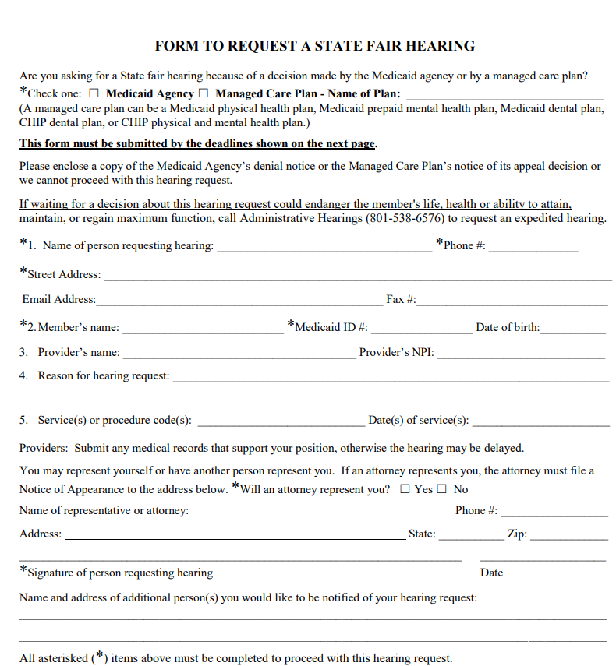
New Form For Requesting a State Fair Hearing
https://medicaid.utah.gov/Documents/pdfs/Forms/HearingRequest2019.pdf

Slide 60
Long Acting Reversible Contraceptive Post Delivery
Long-acting reversible contraceptive (LARC) devices, inserted following a delivery, will be excluded from the DRG reimbursement calculation and will be separately paid according to the fee schedule as an additional amount to the DRG reimbursement calculation
Facilities must include the appropriate LARC HCPCS code on the submitted claim in order to be adjudicated correctly
All rates can be found in the Coverage and Reimbursement Lookup Tool
LARC devices are only reimbursable when used in accordance with manufacturer’s full prescribing information guidelines
Post payment reviews may be done and recoveries made if initially inappropriately paid
This reimbursement change is pending CMS approval of Utah State Plan, Attachment 4.19-A Inpatient Hospital
Upon approval, claims with date of service January 1, 2019, or later will be reprocessed according to the revised policy
The professional insertion fee (e.g., CPT code 58300) continues to be paid separately based on billings from the medical professional on the CMS-1500 claim

Slide 61
Accountable Care Organization (ACO) County Update
Effective January 1, 2019, the SelectHealth Community Care Medicaid ACO plan will be available statewide to all voluntary and mandatory enrollment counties
As a reminder, Medicaid members living in voluntary counties have the option to choose an available ACO health plan or use the Fee for Service Network, while those living in mandatory counties must choose an ACO health plan or they will be assigned to one
An updated ACO plan chart by county, effective January 1, 2019, is listed in the table on the next slide

Slide 62
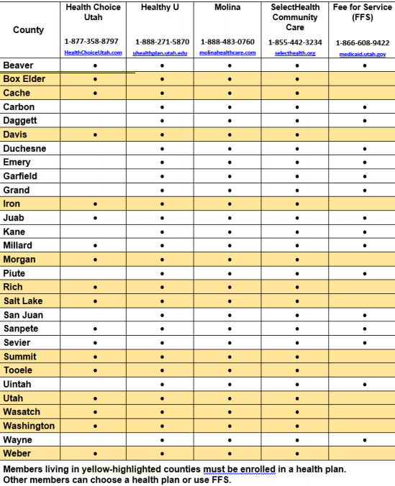
Accountable Care Organization (ACO) County Update

Slide 63
Medicaid Expansion
On February 11, 2019, Governor Herbert signed Senate Bill 96 (2019 Legislative Session) into law.
This bill supersedes previous Medicaid Expansion efforts and replaces Proposition 3 (2018 General Election)
The State is working closely with the Centers for Medicare and Medicaid Services (CMS) as we submit new 1115 Waiver proposals
We are optimistic that CMS will provide greater flexibility as Utah crafts its own Medicaid expansion solutions
This new law expands Medicaid to parents and adults without dependent children earning up to 100% federal poverty level (approximately $12,490 annual income for an individual)
Approximately 70,000 – 90,000 Utah residents will become newly eligible for Medicaid
Approximately 40,000 individuals from 101-138% FPL will continue to receive services through the federal Marketplace
Beginning April 1, 2019, individuals may submit their applications to DWS to enroll in the Adult Expansion Medicaid program: https://medicaid.utah.gov/apply-medicaid
Submitting an application for benefits does not guarantee coverage

Slide 64
Medicaid Expansion
Under Medicaid Expansion:
Parents receive the Non-Traditional Medicaid benefit package
Adults without dependent children receive the Traditional Medicaid benefit package
Coverage is generally provided through direct payments to providers (i.e., Fee for Service) through 2019
It is anticipated that in 2020 many individuals will transition to managed care plans for their physical and behavioral health services
On July 31, 2019, the State submitted a new 1115 Waiver to CMS called the Per Capita Cap Plan
This plan is intended to replace the "Bridge Plan" but must receive CMS approval before implemented
The Per Capita Plan covers adults up to 100% FPL and requests the following provisions: self-sufficiency requirement, enrollment cap, up to 12-month continuous eligibility, employer-sponsored insurance enrollment, lock-out for intentional program violation provision, and a per capita cap
This plan will also request 90% federal/10% state funding

Slide 65
Medicaid Expansion
Expansion Plan Provisions | Bridge | Per Capita Cap | Fallback | Full Expansion
Timeline | Effective April 1, 2019 | Upon CMS Approval (Submit Waiver to CMS Spring 2019) | Upon CMS Approval (Submit Waiver to CMS by March 15, 2020) | July 1, 2020 (if needed)
Federal Poverty Level | 100% | 100% | 138% | 138%
Authority | Waiver | Waiver | Waiver | State Plan
Presumptive Eligibility (PE) | Yes | No Hospital PE | No Hospital PE | Yes
Self-Sufficiency Requirement (Work Requirement) | Yes (effective January 1, 2020) | Yes | Yes | No
Authority to Cap Expansion Enrollment | Yes | Yes | Yes | No
Lock-out for Program Requirements/Violations | No | Yes | Yes | No
Require Enrollment in Employer’s Plan with Premium Reimbursement | Yes ( effective January 1, 2020) | Yes | Yes | No
12-month Continuous Eligibility | No | Yes | No | No
Use Federal Funds for Housing Supports | No | Yes | No | No
Use of Federal Funds Limited by Per Capita Cap | No | Yes | No | No
Benefit Plan for Adults Without Dependent Children | Traditional Medicaid | Traditional Medicaid | Traditional Medicaid | ABP Traditional
Benefit Plan for Parents | Non-Traditional Medicaid | Non-Traditional Medicaid | Non-Traditional Medicaid | ABP Traditional
Early and Periodic Screening, Diagnostic and Treatment (EPSDT) | No | No | No | Yes
Dental Benefits | Emergency Only | Emergency Only | Emergency Only | Emergency Only
Funding (% federal/% state) | 70/30 | 90/10 | 90/10 | 90/10
Counties Provide Match for Behavioral Health | No | No | No | No
Delivery System | Fee for Service - except Parents 45-60% FPL (Managed Care after January 1, 2020 - Except Rural Counties) | Managed Care (except Rural Counties) | Managed Care (except Rural Counties) | Managed Care (except Rural Counties)

Slide 66
Electronic Visit Verification (EVV)
Electronic visit verification (EVV) requirements, defined in section 12006 of the 21st Century Cures Act, are effective for Utah Medicaid beginning July 1, 2019
EVV requirements apply to all personal care services and home health care services provided under the State Plan or a 1915 (c) Home and Community Based Waiver
The effective date is for both personal care services and home health services; however, disallowance for claims with incomplete records will not occur until January 1, 2020, for personal care services and January 1, 2023, for home health care services

Slide 67
Electronic Visit Verification (EVV)
Choice of reporting systems for EVV are by provider preference but must meet all federal requirements, including the standards set in the Health Insurance Portability Accountability Act. The State will not implement a mandatory model for use. All provider choice EVV systems must be compliant with requirements of the Cures Act including:
1) type of service performed;
2) individual receiving the service;
3) date of the service;
4) location of service delivery;
5) individual providing the service; and
6) time the service begins and ends

Slide 68
Customized Wheelchairs
Power wheelchairs and customized wheelchairs require prior authorization
The required forms can be found on the Medicaid website and must be submitted with wheelchair prior authorization requests, effective July 1, 2019 :
Utah Medicaid Initial Wheelchair Evaluation Form (power and manual chairs)
Utah Medicaid Power Wheelchair Training Checklist (power chairs only)
In addition, the Utah Medicaid Final Wheelchair Evaluation Form must be completed upon delivery of the wheelchair and submitted to Medicaid Operations by fax at 801-536-0481, before the claim will be paid
Note: This form is also located on the Medicaid website

Slide 69
Customized Wheelchairs
Effective July 1, 2019 , providers reporting wheelchair evaluations must use CPT codes 97535 and 97542; These codes do not require prior authorization
Wheelchairs and identified accessory items will be bundled and reimbursed as a complete package
Additional information can be found within the Medical Supplies and Durable Medical Equipment Manual Chapter 8-14 Wheelchairs

Slide 70
Questions and answers

Slide 71
Utah PRISM Project

Slide 72
PRISM Project Overview
Utah Medicaid is replacing the Utah Medicaid Management Information System (MMIS)
The new system is called PRISM, which is the Provider Reimbursement Information System for Medicaid
The Provider Enrollment web based system of PRISM was implemented in July 2016 with changes coming Summer 2020
PRISM is a multi-year project, continuing through the end of 2022

Slide 73
PRISM Provider Enrollment
Providers have been using the existing PRISM system since July 2016
New enrollments
Modifying enrollment information
Revalidation (re-credential) of their enrollment
10,000 + newly enrolled providers in PRISM since July 2016
Applying for Medicaid Promoting Interoperability (Meaningful Use) incentive payments

Slide 74
PRISM Provider Enrollment Changes
in Summer 2020
Provider Enrollment changes coming in Summer 2020 include:
Initial log-in process
Re-enrollment process
Updated enrollment types and enrollments steps
Auto generated notices to providers when it’s time to complete the revalidation (re-credential) process and when provider licenses are expiring
PRISM website has a list of frequently asked questions (FAQs) related to the changes coming in Summer 2020
https://medicaid.utah.gov/prism-faq

Slide 75
PRISM Project Timeline
The core components of PRISM are scheduled to be implemented in early 2022, including:
Managed Care Processes
Claims Adjudication
Claims Payments
The last major component of PRISM is scheduled to be implemented at the end of 2022, which will include:
Member Web Portal
Audit Studio (Fraud and Abuse System)

Slide 76
Communication and Training
To learn more about the changes coming to PRISM’s Provider Enrollment
Read the quarterly Medicaid Information Bulletin (MIB) articles regarding PRISM
Check the PRISM website for updates regarding the upcoming changes: https://medicaid.utah.gov/prism
In Summer 2020, eLearning Modules will be available for Providers
Modules will give step by step instructions
eLearning modules will be located on the Medicaid website: https://medicaid.utah.gov/prism-provider-training
Frequently asked questions will be available at: https://medicaid.utah.gov/prism-faq

Slide 77
Providers Currently Using PRISM
Current Medicaid Providers:
Providers will be notified in writing by Summer 2020 when and how they need to access PRISM to validate their enrollment information and make any needed changes
Online training will be available to assist, along with contact information
Claims will continue to be paid out of the Legacy MMIS System until the end of 2022

Slide 78
Contact Information
For Provider Enrollment questions using the existing PRISM system, call the Provider Enrollment Team:
1-800-662-9651 or 801-538-6155, press option 3, and then option 4
For questions regarding the changes coming to PRISM, email: prism@utah.gov

Slide 79
Prior Authorization

Slide 80
Prior Authorization on the Website
https://medicaid.utah.gov
Notes:
Prior Authorization is located under Health Care Providers
Section Contains Everything you need in order to complete and submit a prior authorization

Slide 81
Where Do I Locate Forms?
Notes:
All necessary forms are located in this section. Includes forms for Pharmacy, Resident Assessment, as well as all General PA forms. Most forms will be under the General PA Forms section

Slide 82
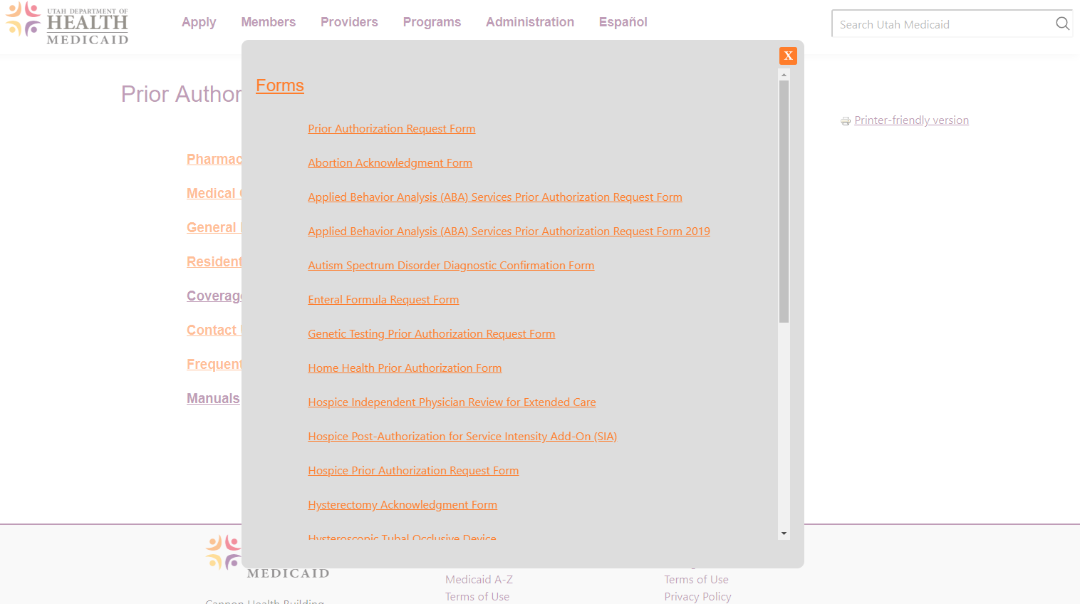
Prior Authorization Request Forms
Notes:
We have five different Prior Authorization Request Forms: General, ABA, Hospice, Enteral Formula, Genetic testing. This is also where all other forms are located including consent forms, wheelchair training and checklists, etc.

Slide 83
Request Form Basics
Use correct form for requested service
Use updated request forms
Fill in required fields
Use spaces provided
Fax to appropriate number
Forms can be typed
Fee for Service and carve-out requests only
Example attachments in downloads
Notes:
When filling out a PA request form, make sure you use the correct form for the requested service. If there is not a form specific to your service, use the general PA request form. Also use the most updated version, all forms now typeable, required fields are required, use spaces provided (no shoving 6 codes on 1st page), fax to correct fax number, use only for FFS members (unless carve out service) We attached examples of each PA request form, Examples are filled out with “call-out” boxes that provide additional information for things that are often missed or filled out incorrectly.

Slide 84
Prior Authorization Helpful Tips
Check member eligibility: https://medicaid.utah.gov/eligibility-lookup-tool
Check Coverage and Reimbursement Lookup Tool: http://health.utah.gov/medicaid/stplan/lookup/CoverageLookup.php
Only submit clinical documentation that is current and relevant
Include all required documents, forms, and/or consents
Include required modifiers (e.g. LL, RR, RT, LT)
Include conservative treatment documentation, including type of treatment and length of treatment
Notes:
Additional Helpful Tips when requesting a Prior authorization

Slide 85
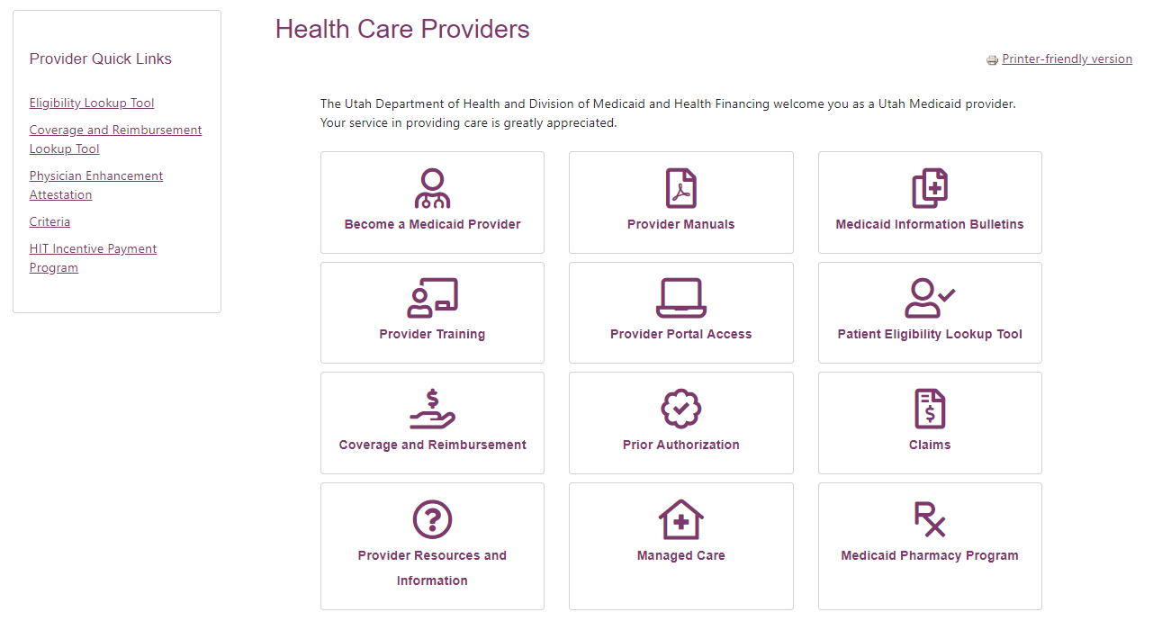
Lookup Tools
Notes:
We have some helpful tools available online. There are a couple ways you can access these tools. The easiest and quickest way is to use the Provider Quick Links under the Health Care Providers tab. It is important ot use these tool prior to completing a Prior Authorization request form.

Slide 86
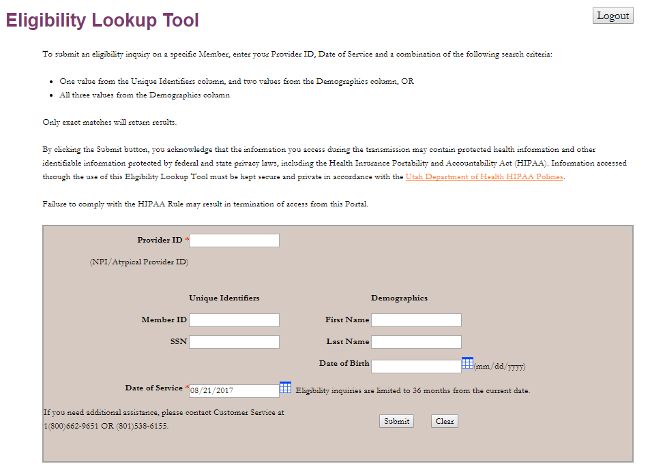
Eligibility Lookup Tool
Log-in required
Provides detailed member eligibility information
Pro Tips
Use Medicaid ID#, First Name, and Date of Birth
Make sure no spaces or characters at end
Verify the next month’s eligibility up to 6 days prior to end of month
Notes:
Look up eligibility before each request is sent. Be sure to determine if a member is enrolled in an ACO. If the member is enrolled in an ACO, the PA requests should be sent to the ACO and not to FFS unless the service being requested is a carve out service.

Slide 87
Coverage and Reimbursement Lookup
Select appropriate provider type
Enter 5 character HCPCS/CPT code
Enter date of service (if future, keep current date)
Inquire on retroactive coverage for the previous 2 years
Non-covered services will show up as “not billable by provider type”
Notes:
The Coverage and Reimbursement Code Lookup will provide detailed code specific coverage information.

Slide 88
Coverage and Reimbursement Lookup
Notes:
Make sure you are scrolling down when looking up codes. This is an example for a pediatric hospital bed. One table provides information for a rental, and the other for a purchase. Pay attention to the special notes, as the information provided may differ.

Slide 89
What Happens to My Request?
Approved
You will receive a fax stating the request is approved with the prior authorization attached
Pended (temporary internal status)
Data Entry Review – Requests that have been verified to have all data entry items completed on the correct form and are pending a primary clinical review for medical necessity
Secondary Review - Requests that have undergone a primary clinical review and have been referred on for a higher level review (e.g. review by physician or utilization review committee)
Returned
Data Entry – You will receive a return letter addressing the data entry items that are incomplete or incorrect (e.g. outdated form, incorrect Medicaid ID#, missing a required field)
Clinical - You will receive a return letter addressing what clinical documentation is missing, upon resubmission, you must include the following:
Address every issue that was mentioned in the return letter and include all original documentation
Update your PA request form (e.g. date of request)
Denied
You will receive a denial letter explaining what was denied and why
A Request for Hearing form will be attached and must be submitted within 30 days of the date of denial

Slide 90
Retroactive Authorization
There are limited circumstances when a prior authorization would be given after a service is rendered:
Retroactive Medicaid eligibility
Retroactive authorization must be requested within 90 days of Medicaid eligibility determination
Medical supplies provided in a medical emergency
Retroactive authorization must be requested within 90 days of the medical emergency
Medical emergency
Retroactive authorization must be requested within 90 days of medical emergency

Slide 91
Retroactive Authorization
Surgical exceptions (e.g. surgical procedure changed or discovered intraoperatively)
Retroactive authorization must be requested within 90 days of surgical procedure
Anesthesia exceptions (e.g. surgeon did not obtain prior authorization)
Complete the request for prior authorization and include the reason the service was provided without prior authorization
Include all required medical record documentation and send the request to the appropriate fax number listed on the request form or form instructions
See the Section 1 Medicaid manual for complete details

Slide 92
Where Can I Find Criteria?
Other Sources
Coverage and Reimbursement Lookup Tool
Email medicaidcriteria@utah.gov for specific criteria that can’t be found on the web (24 hour response time)
Notes:
Required criteria may be found in a few different areas of the website

Slide 93
What’s New in Prior Authorization
Updated PA request forms
Substance Use Residential Treatment
Hospice
Applied Behavior Analysis (ABA) Services
New PA request forms
Home Health
Physical/Occupational Therapy
Update to InterQual criteria and provider manuals
Updated PA requirements
New staffing and method for how prior authorization requests are processed

Slide 94
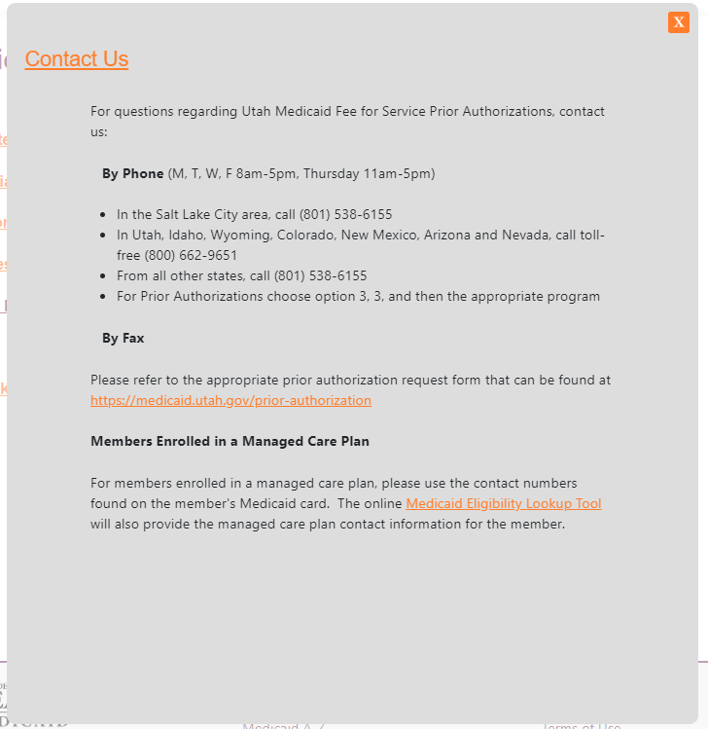
FAQ’s and Contact Info

Slide 95
Questions and answers

Slide 96
Utah Office of Inspector General of Medicaid Services

Slide 97
About Utah OIG
The Utah Office of Inspector General (Utah OIG) is an independent government agency tasked by statute to conduct oversight of the Utah Medicaid program. This includes audits, inspections, investigations, monitoring, education and training, and policy reviews.
Utah OIG is able to make recommendations to Medicaid about how to improve operations and efficiency of the program. The office works to identify, prevent and recover taxpayer monies that are expended as the result of fraud, waste and abuse.

Slide 98
Utah OIG Oversight Universe
Medicaid
Program
Management and Oversight
Providers and Contractors
PRISM
DTS
ORS
DWS
OIG
DOH
Program Funding (Source of Revenue)
Grants
Federal
State
County
Contract Providers
FFS Providers
IHS
School Districts
PMHP
ACO
Dental
County
DHS
Waiver Programs

Slide 99
Causes of Improper Payments
Errors
Waste
Abuse
Fraud
Mistakes Inefficiencies Bending Rules Intentional Deception
Common errors include insufficient documentation:
CMS reported in 2015 that insufficient documentation was the “most common error”
Overpayments may have been proper, but lack of documentation caused recovery as overpayment
Majority of improper payments are unintentional errors (CMS, 2015)
Utah OIG identifies all causes of improper payments:
From mistakes to intentional deception

Slide 100
Utah OIG Statute – §63A-13-102
Definitions
Fraud:
“intentional or knowing:
Deception, misrepresentation, or upcoding in relation to Medicaid funds, costs, a claim, reimbursement, or services; or
a violation of a provision of Sections 26-20-3 through 26-20-7”
Waste:
“Overutilization of resources or inappropriate payment”
Abuse:
“(a) an action or practice that:
(i) is inconsistent with sound fiscal, business, or medical practices; and
(ii) results, or may result, in unnecessary Medicaid related costs; or
(b) reckless or negligent upcoding”

Slide 101
Most Common Fraud and Abuse
CMS reports the following as the most common types of fraud and abuse in Medicaid:
Billing for unnecessary services and equipment/supplies
Billing for services or items not rendered
Upcoding
Unbundling
Billing for non-covered services or items
Kickbacks
Recipient fraud (identity theft, eligibility, card sharing, doctor shopping, drug diversion)

Slide 102
Taxpayer Dollars and Resources
Utah OIG Mission:
Protect taxpayer resources
Promote success of the Medicaid program through best practices, policy support and training
Manage careful balance between:
Proper payment of claims; and
Limiting burden on provider community through investigations and reviews to identify and prevent fraud, waste and abuse
63A-13-202(1)(L)(ii):
“balance efforts to reduce costs and avoid or minimize increased costs of the state Medicaid program with the need to encourage robust health care professional and provider participation in the state Medicaid program”

Slide 103
Audit
Performs audits (i.e. determines the nature, scope and direction of the audit; reviews and analyzes available information, identifies potential issues, schedules audit, prepares audit work papers, etc)
Analyzes, summarizes and/or reviews data; reports findings, interprets results and/or makes recommendations
Writes or drafts correspondence, reports, documents and/or other written materials
Ensures compliance with applicable federal and/or state laws, regulations, and/or agency rules, standards and guidelines, etc
Plans and manages projects and/or programs. Writes (or discusses) project/program plan(s), recommendation(s) and/or finding(s) with departments or organizations

Slide 104
Data
Access to Medicaid claims data
Data can confirm credible allegation of fraud
Assist nurse investigators and auditors in investigations
Have ability to look at data for reported or suspected billing inconsistencies
Pull monthly random samples to check for billing inconsistencies
Data is not a standalone tool for fraud detection, but can identify patterns of fraudulent behavior not otherwise apparent
Together with other tools, can help identify suspected fraud

Slide 105
Program Integrity (PI)
Medicaid Program Integrity is a system of reasonable and consistent oversight of the Medicaid program. Program Integrity effectively:
Encourages compliance
Maintains accountability
Protects public funds, both federal and state
Supports awareness and responsibility
Ensures that providers meet participation requirements
Ensures that services are medically necessary
Ensures payments are for the correct amount and for covered services
The goal of Program Integrity is to reduce and eliminate fraud, waste, and abuse in the Medicaid program. The program integrity function seeks to fulfill that goal through prevention, investigations, education, audits, recovery of improper payments, and cooperation with the Medicaid Fraud Control Unit (MFCU).

Slide 106
Program Integrity
42 CFR § 455.13 – Methods for identification, investigation and referral: The UOIG must create methods and criteria for identifying suspected fraud cases
42 CFR § 455.14 – Preliminary Investigation: The UOIG investigates all allegations of fraud, waste, or abuse referred to the office
42 CFR § 455.15 – Full Investigation: If the preliminary investigation leads the agency to believe that fraud or abuse has occurred, we must refer the case to the Medicaid Fraud Control Unit (MFCU)
42 CFR § 455.20 – Beneficiary Verification: The UOIG fields referrals from recipients who received an EOMB from Utah Medicaid, but are concerned that they did not receive the services
42 CFR § 455.21 – Cooperation with State Medicaid Fraud Control Unit: The UOIG must refer all suspected cases of provider fraud to the MFCU
42 CFR § 455.23 – Suspension of payments in cases of fraud: The UOIG must suspend all Medicaid payments to a provider after the agency determines there is a credible allegation of fraud for which an investigation is pending, unless the agency has good cause to not suspend payments or to suspend payment only in part
42 CFR § 456.23 – Post payment review process: The UOIG must develop and review beneficiary utilization profiles, provider service profiles, and exceptions criteria. This allows us to correct misutilization practices of beneficiaries and providers.

Slide 107
Special Investigations Unit (SIU)
Intake of complaints
Conducts preliminary reviews to verify complaints
Makes referrals to other entities and makes termination recommendations
Performs comprehensive reviews on providers
Conducts site visits
Educates providers
Participates in OIG-initiated focused reviews and special projects

Slide 108
Policy
Policy Reviews:
Required by Utah OIG Statute
Review and advise on policy questions for audits and investigations
Conduct reviews of draft Medicaid policies prior to publication:
MIBs, Provider Manuals, Rules and State Plan Amendments
Identify potential conflicts or concerns in policy

Slide 109
Training
Provider Training:
Partnership Building:
Improve the program for the providers and recipients – protecting taxpayer resources through efficiencies
Share policy recommendations and changes
Information sharing about current oversight trends
Develop audit, policy and investigation leads and contacts
Utah OIG can participate in training, seminars and conferences

Slide 110
Reporting to the Utah OIG
SUSPECTED FRAUD, WASTE OR ABUSE MAY BE
REPORTED TO THE UTAH OFFICE OF INSPECTOR
GENERAL. REPORTS CAN COME FROM ANYBODY AND
CAN BE ANONYMOUS. PLEASE CALL THE UTAH OIG
HOTLINE:
(855) 403-7283
OR COMPLETE A REFERRAL ON THE UTAH OIG WEBSITE:
https://oig.utah.gov/

Slide 112
UOIG Contacts
Andrew Hill
Program Integrity Manager
andrewhill@utah.gov
Gene D. Cottrell
Inspector General
gcottrell@utah.gov
John Slade
Special Investigations Manager
jslade@utah.gov
Nate Johansen
Deputy Inspector General
nmjohansen@utah.gov
Neil Erickson
Audit Manager
neilerickson@utah.gov

